Slide 1
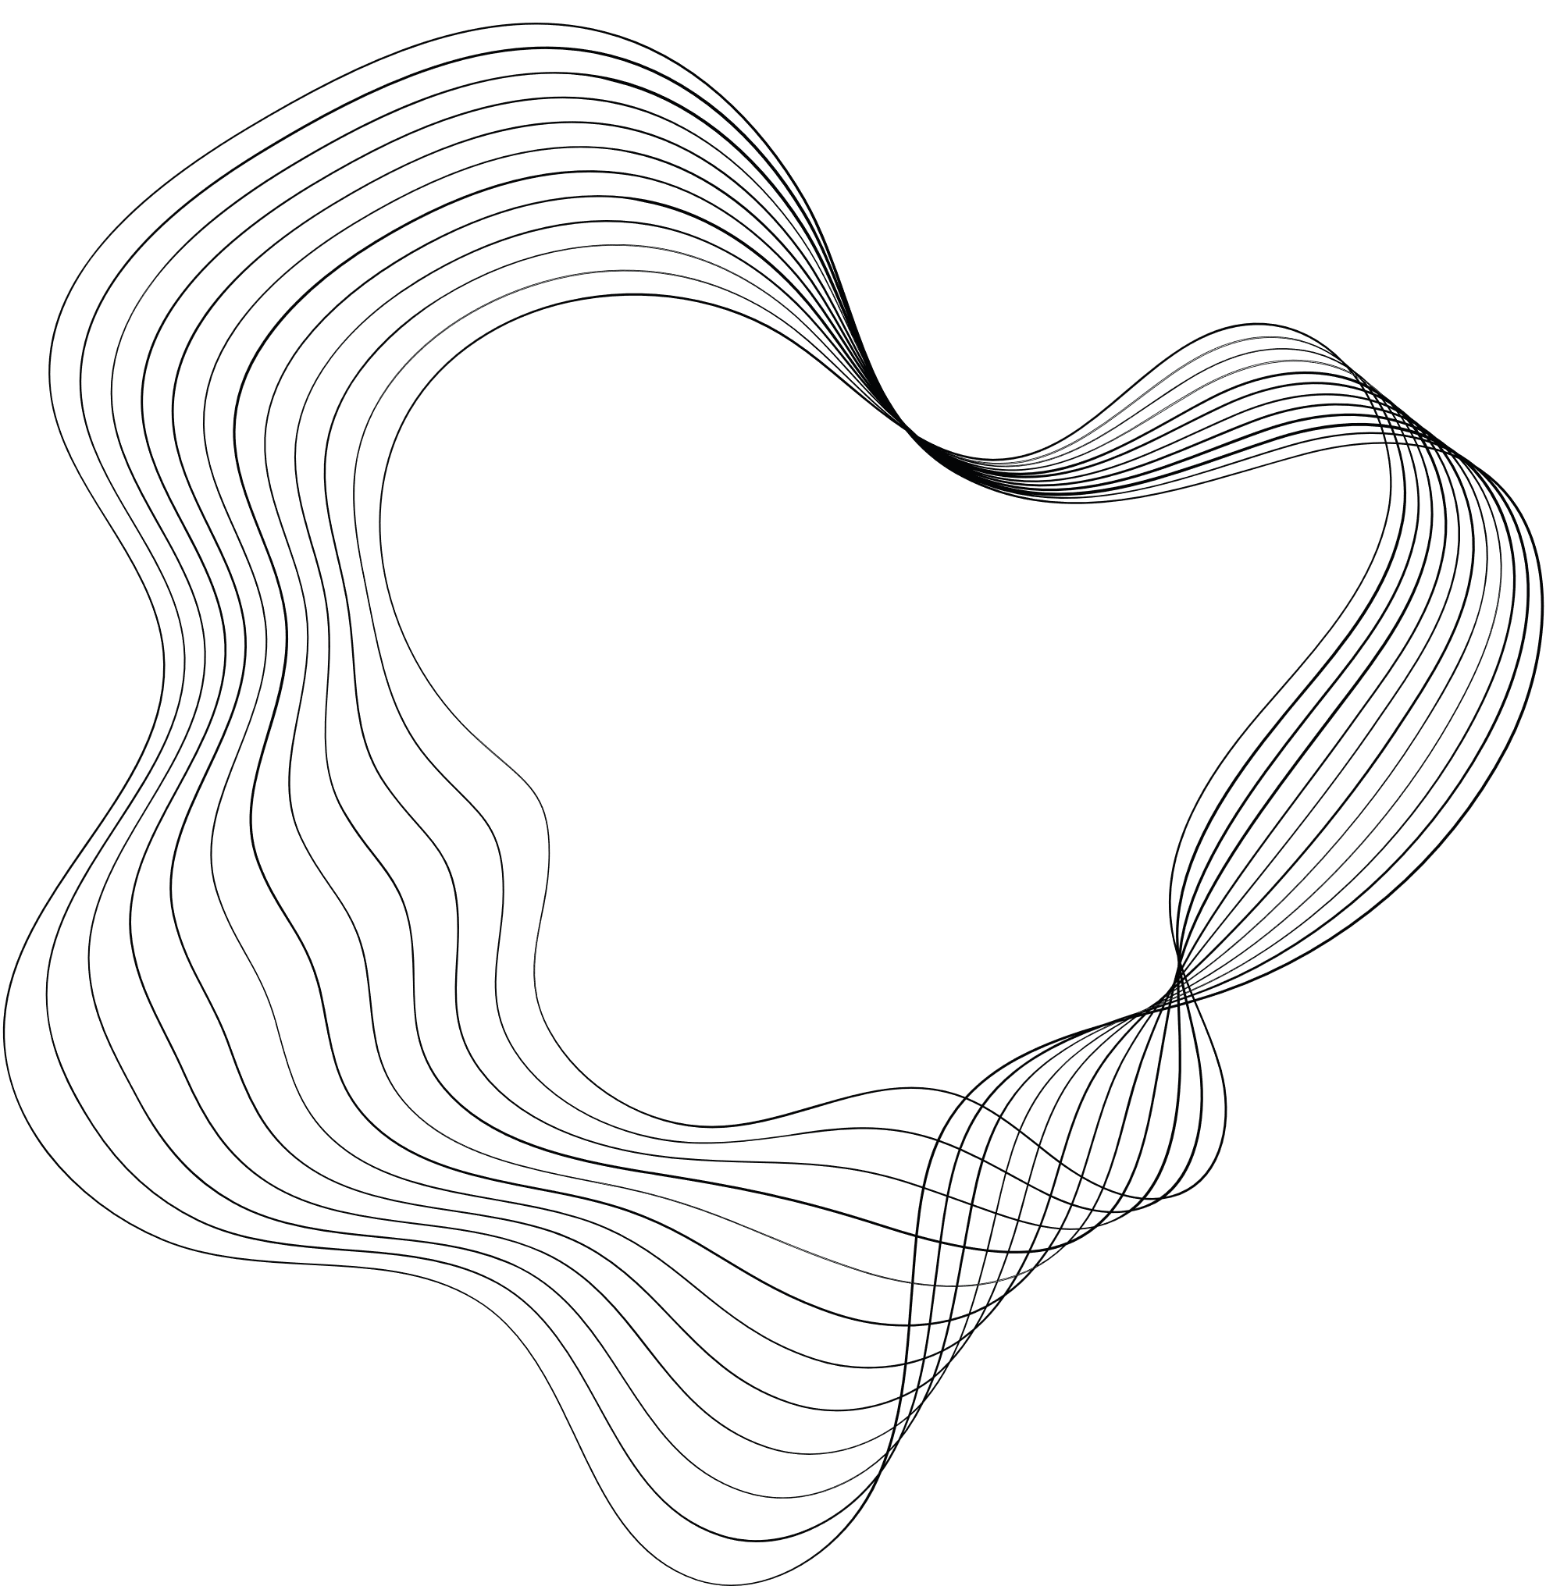

PREDICTIVE
ANALYSIS
PROJECT
BY: RISHI GANDHI & SUHANI SHAH
J022, J060

Slide 2


CONTENT
01
CHOOSING THE TABLE
02
REPLACEMENT NODE
03
DATA PARTITION NODE
04
DECISION TREES
05
REGRESSION
06
NEURAL NETWORK
07
MODEL COMPARISON

Slide 3
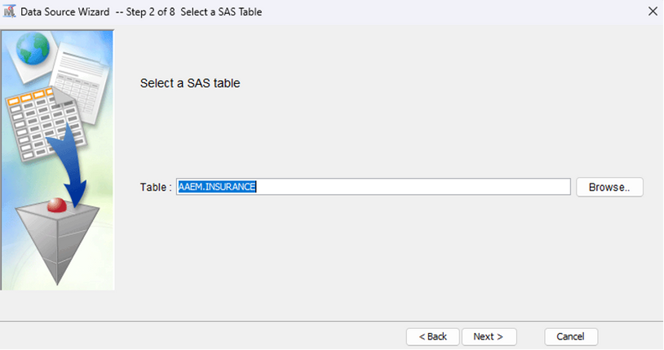
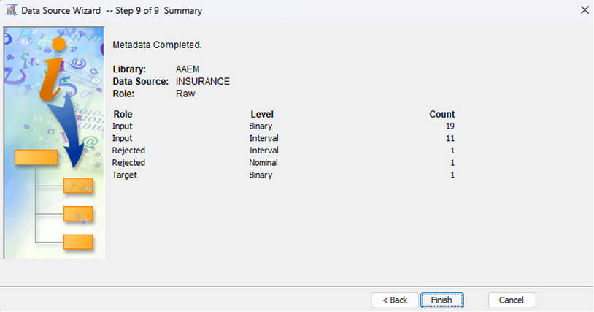
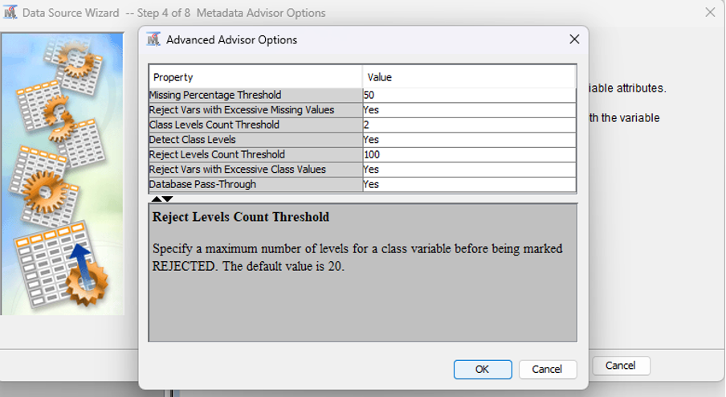
CHOOSING THE TABLE
We have chosen the ‘INSURANCE’ dataset available in AAEM library
Reject variables with an excessive number of missing values (default=50%)
We have entered 2 as the Class Levels Count Threshold value so that only binary numeric variables are treated as categorical variables.
We have entered 100 as the Reject Levels Count Threshold value so that only character variables with more than 100 distinct values are rejected.
Data Source Wizard provides summary details about the data table that we created.

Slide 4
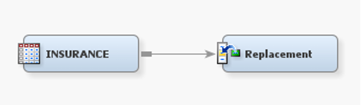
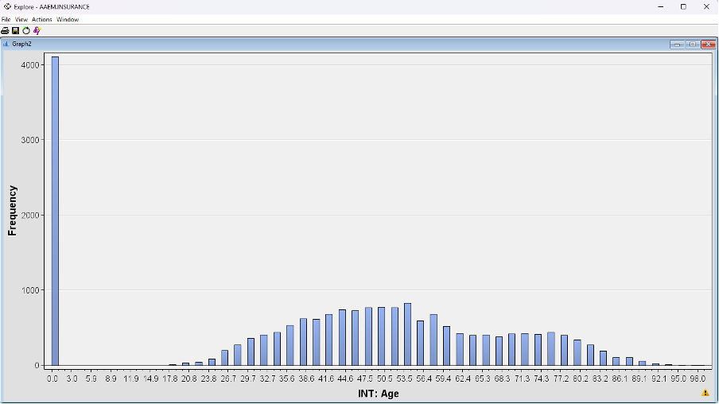
ADDING REPLACEMENT NODE
HISTOGRAM OF THE DATASET

Slide 5
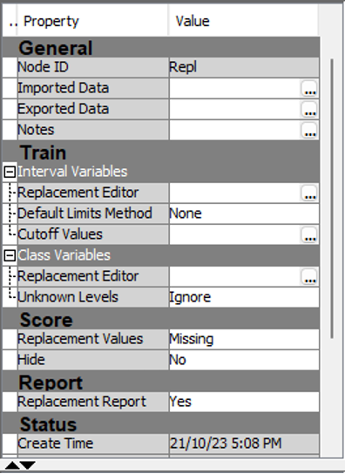
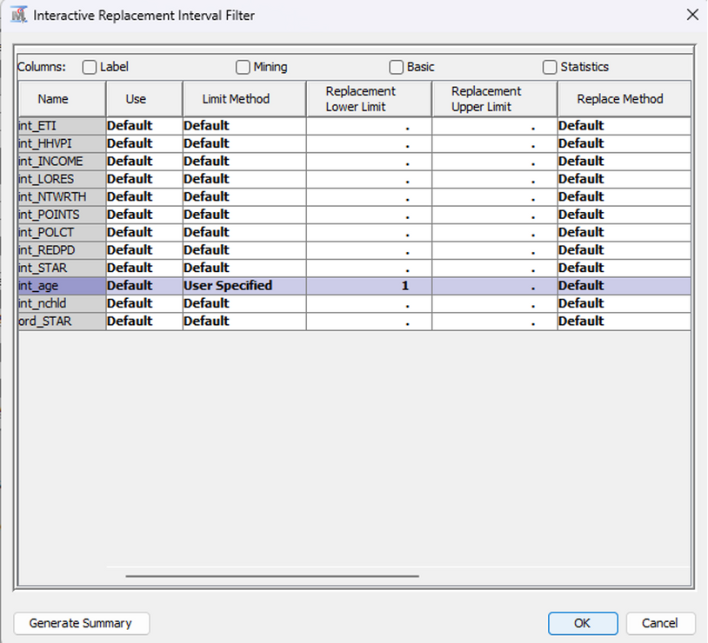
CHANGING THE REPLACEMENT NODE PROPERTIES
You want to replace improper values with missing values. To do this, you need to change the Replacement Value property. Select missing to specify values you want to replace
Using this specification, any IntAge values that fall below the lower limit of 1 are set to missing. All other values of this variable do not change.

Slide 6
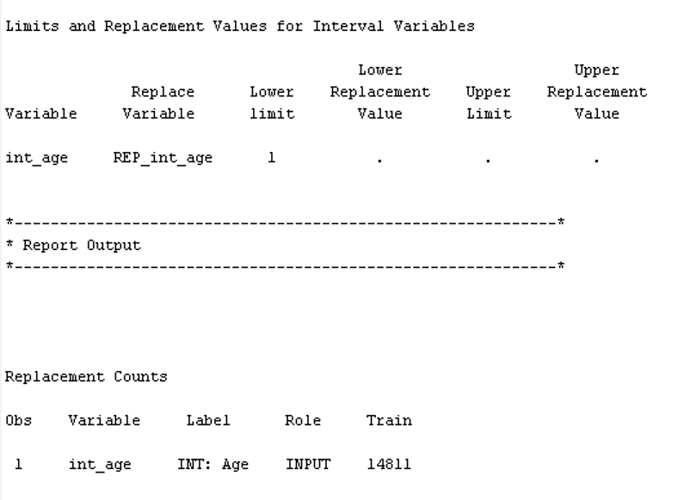
RESULTS FOR REPLACEMENT NODE
The Replacement Counts window shows that 14811 observations were modified by the Replacement node as missing values. The Interval Variables window summarizes the replacement that was conducted.

Slide 7
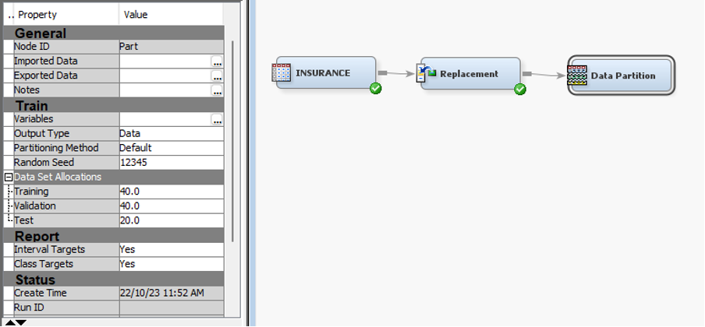
ADDING DATA PARTITION NODE
Entering 40 as the Training value in the Data Partition node.
Entering 40 as the Validation value in the Data Partition node.
Entering 20 as the Testing value in the Data Partition node.

Slide 8
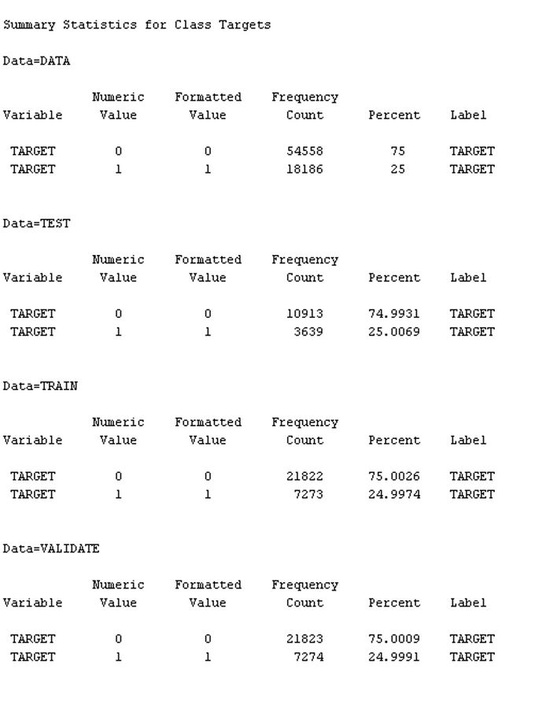
SUMMARY OF DATA PARTITION NODE
The Results - Node: Data Partition window provides a basic metadata summary of the raw data that feeds the node and, more importantly, a frequency table that shows the distribution of the target variable, TARGET, in the raw, training, and validation data sets.

Slide 9
MODELLING
Many predictive modeling tools are found in SAS Enterprise Miner. The tools can be loosely grouped into three categories: primary, specialty, and multiple models. The primary tools interface with the three most commonly used predictive modeling methods: decision tree, regression, and neural network.
Decision trees are a fantastic starting point for predictive modeling. Much like all of the modeling techniques, decision trees tackle each of the modeling essentials outlined in the introduction. By using prediction rules, cases are scored, while a split-search algorithm aids in input selection. Pruning is used to manage model complexity.

Slide 10
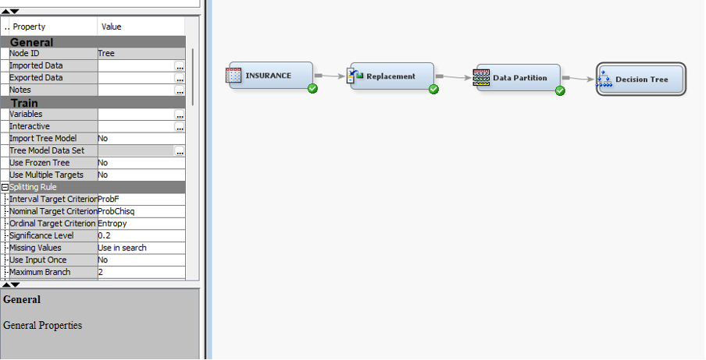
DECISION TREES

Slide 11
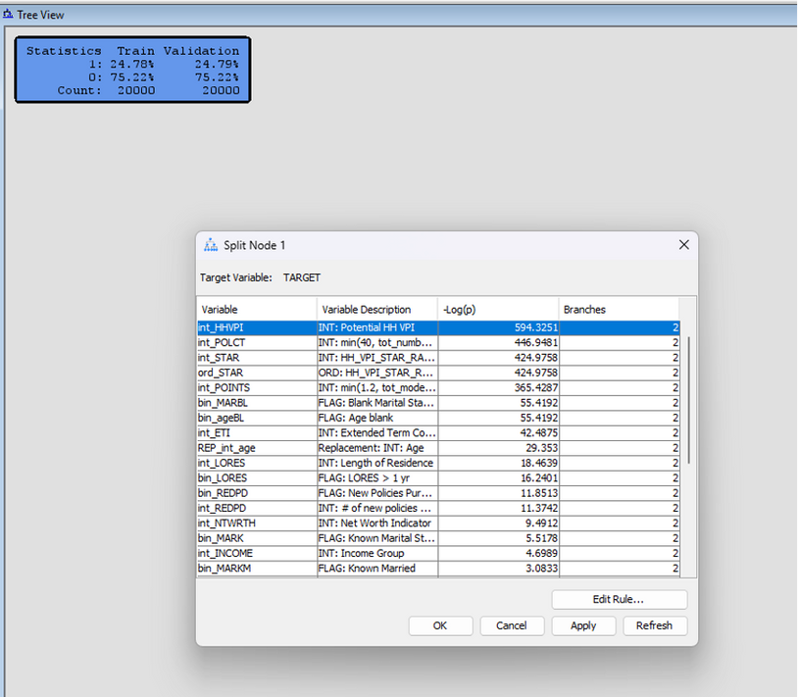
DECISION TREES
Open interactive decision tree and start splitting the nodes. The Split Node dialog box shows the relative value, -Log(p) or logworth, of partitioning the training data using the indicated input. As the logworth increases, the partition better isolates cases with identical target values
Start splitting the nodes one can customize the values using edit rule.
This prompts the question: Where do you stop splitting? The validation data provides the necessary information to answer this question.
If the model's performance improves with a split, it might be a good idea to keep it. If the performance decreases, the split might be unnecessary, and you might need to prune the tree or stop further splitting.

Slide 12
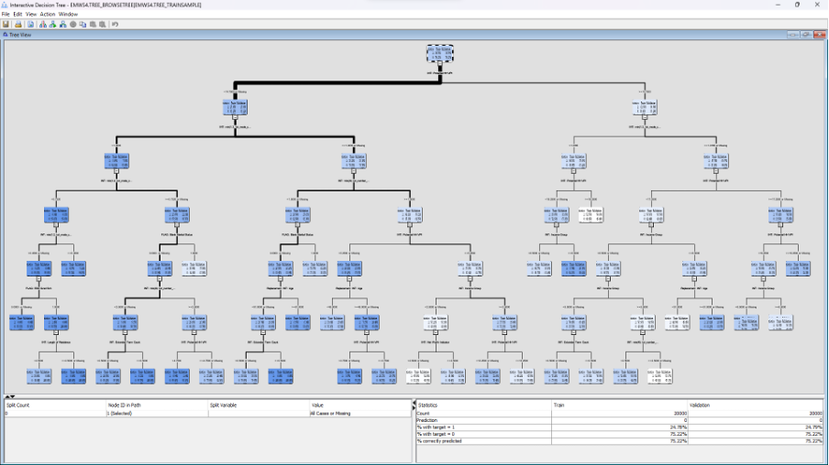
DECISION TREES
more automated ways to grow a tree is to do it through creating a maximal tree

Slide 13
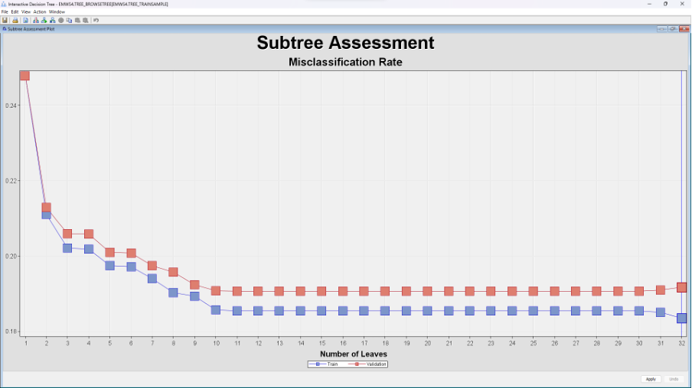
MISCLASSIFICATION RATE
Overfitting Point: Initially, as the tree grows, both training and validation misclassification rates decrease. However, after a certain number of leaves, the training rate continues to decrease, but the validation rate starts to plateau or even slightly increase. This divergence indicates potential overfitting, where the model is becoming too tailored to the training data and may not generalize well to new, unseen data.
Optimal Complexity: One way to select the optimal complexity (or size) of the tree is to identify where the validation misclassification rate is the lowest, before it starts to plateau or increase. In this plot, it seems like that point is around 8-10 leaves. Beyond that, adding more leaves doesn't seem to improve the performance on the validation set.
Misclassification rate – 0.18345 at 32 no. of leaves

Slide 14
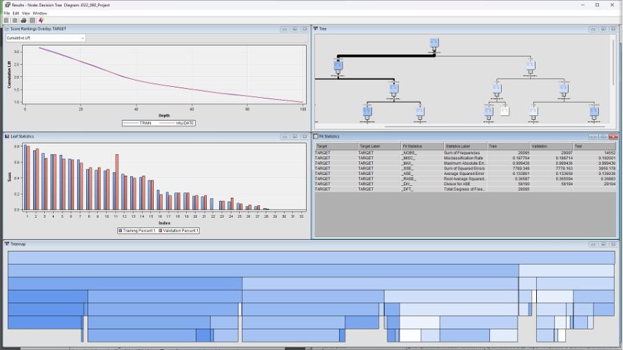
ASSESSING THE DECISION TREE
assessing the decision tree model, evaluating its lift and performance statistics, and visualizing results and data distributions.

Slide 15
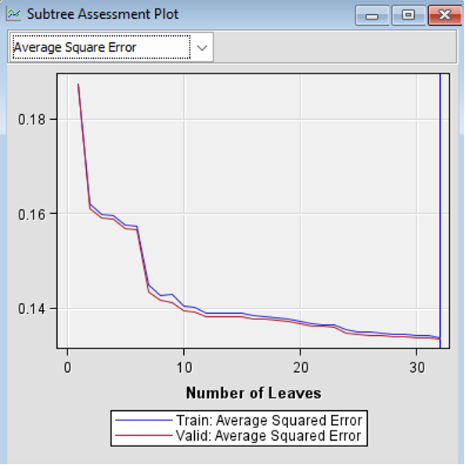
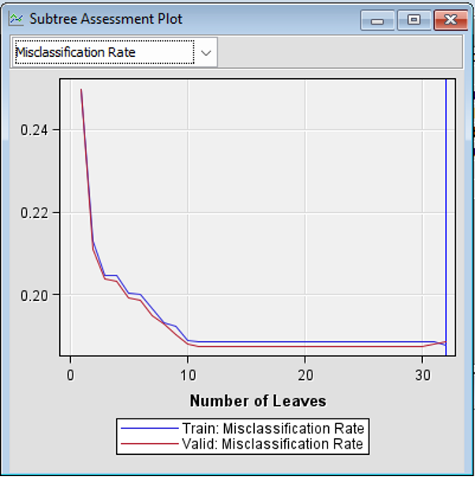
ASSESSING THE DECISION TREE
For both metrics (ASE and misclassification rate), the model's performance on the training and validation sets improves as it grows in complexity (more leaves) up to around 20 leaves. After this point, adding more leaves does not lead to significant improvements in either metric.
The convergence of training and validation curves suggests that the model is neither overfitting (where the training metric would be much better than the validation metric) nor underfitting (where both metrics would be poor).
Choosing a tree size around where the validation metric plateaus (around 20 leaves in this case) could be optimal as it offers a balance between model complexity and performance.
ASE – 0.1337
MR – 0.1878

Slide 16
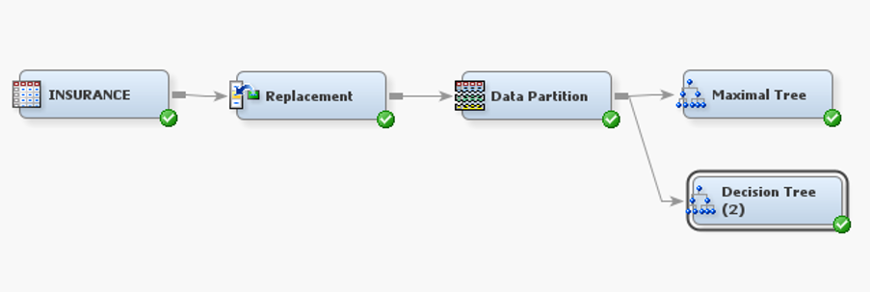
OPTIMAL TREE

Slide 17
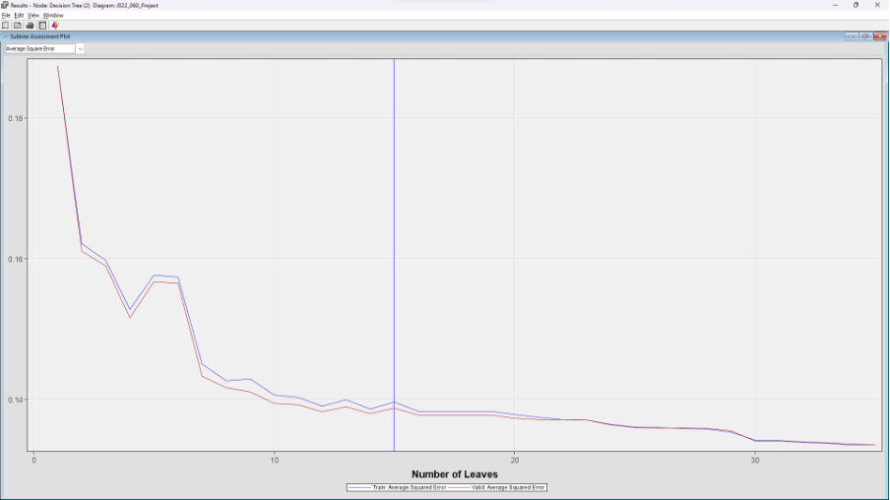
OPTIMAL TREE
Observation: As the number of leaves in the decision tree increases (i.e., the tree becomes more complex), the average squared error for the training set (purple line) decreases, which is expected as the tree fits the training data more closely. However, the average squared error for the validation set (pink line) decreases initially and then stabilizes.
Interpretation: The optimal complexity is likely somewhere around where the validation error stabilizes, before it starts to rise again or where the gap between the training and validation errors starts to widen. This is to avoid overfitting to the training data. From the graph, it looks like this point is between 5 and 10 leaves.

Slide 18
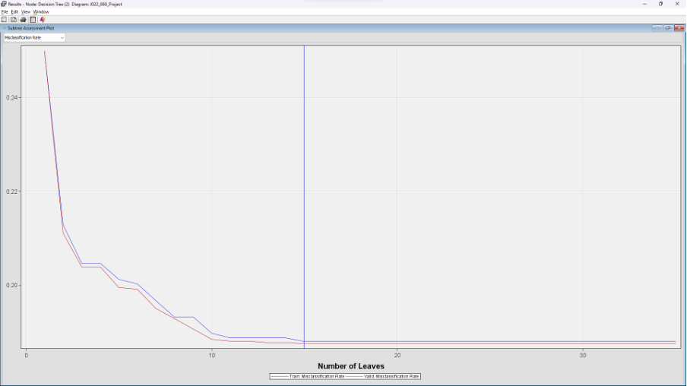
OPTIMAL TREE
Observation: The misclassification rate follows a similar trend to the average squared error. The rate for the training data decreases continuously, but for the validation data, it decreases initially and then levels off.
Interpretation: Again, the optimal tree size is probably where the validation error stabilizes or starts to increase, indicating that further complexity doesn't improve performance on unseen data. The point of stabilization here also seems to be between 5 and 10 leaves.

Slide 19
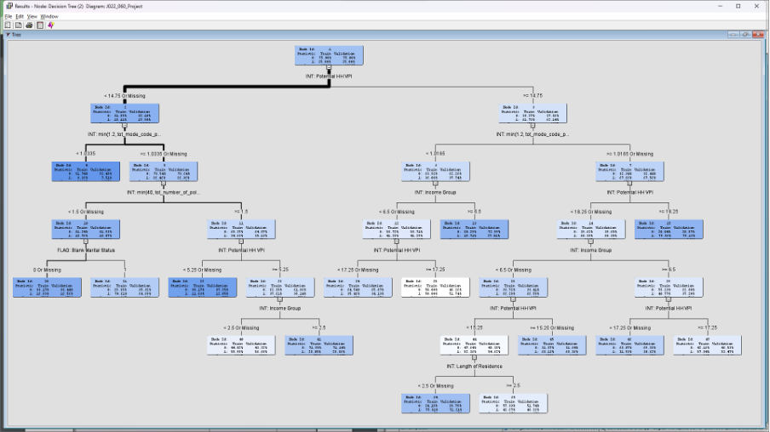
OPTIMAL TREE
Starting from the root, the tree segments data based on conditions. For instance, data points with certain "INT_Potential_HIV" values may follow the left branch, while others follow the right.
The ultimate decision or prediction for a data point is found at the leaves.
The presence of variables like "INT_Potential_HIV" and "INT_Household_Income" at various decision points suggests these factors are significant in determining the outcome.
It's worth noting that variables near the top of the tree (like "INT_Potential_HIV") often have higher importance or influence on the model's decisions than variables introduced later.

Slide 20
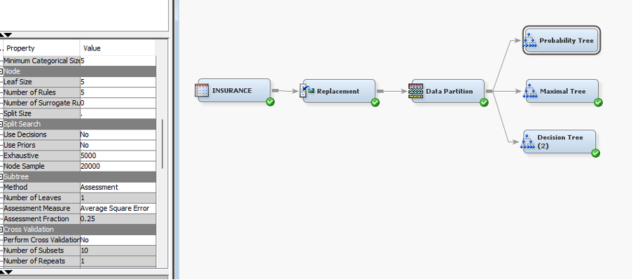
PROBABILITY TREE

Slide 21
PROBABILITY TREE

Slide 22
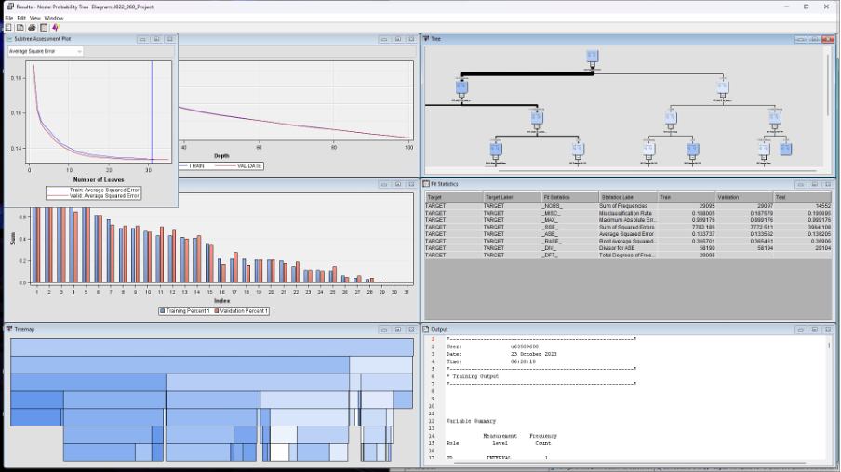
PROBABILITY TREE

Slide 23
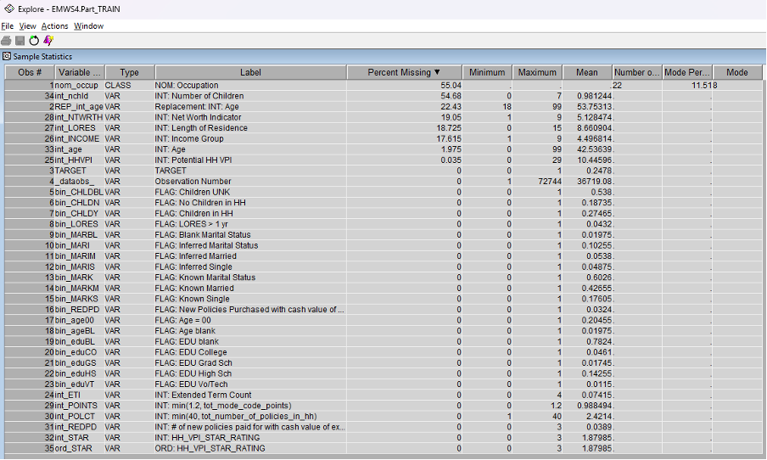
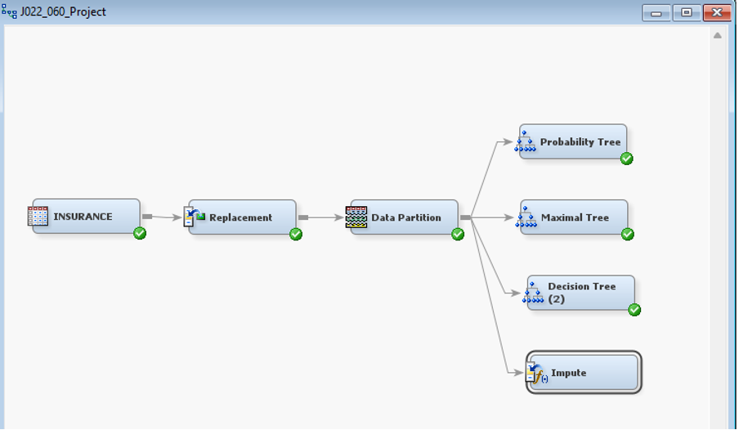
IMPUTE NODE

Slide 24
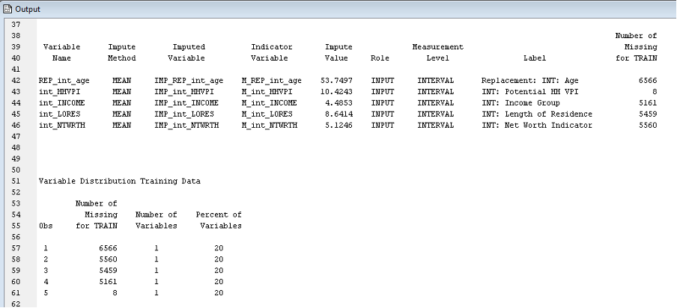
IMPUTE NODE
Variables Handled:
REF_int_age: Replaced missing values with a mean age of approximately 53.75 years.
int_HYPT: Imputed missing values with a mean of about 10.42.
int_INCOME: Missing income values were replaced with a mean of roughly 4.68.
int_LORES: The mean used to replace missing values was approximately 8.61.
int_NWTRTH: Imputed with a mean value of about 5.12.

Slide 25
NOTE
We opted to not utilize the transform variable node since all the variables demonstrated a normal distribution. Additionally, a significant portion of these variables were binary, represented as 1.0.
In our approach, we found no need to employ the replacement node for categorical variables. This decision was informed by the fact that all categorical variables were distinctly represented by 1 & 0, rendering replacement unnecessary.

Slide 26
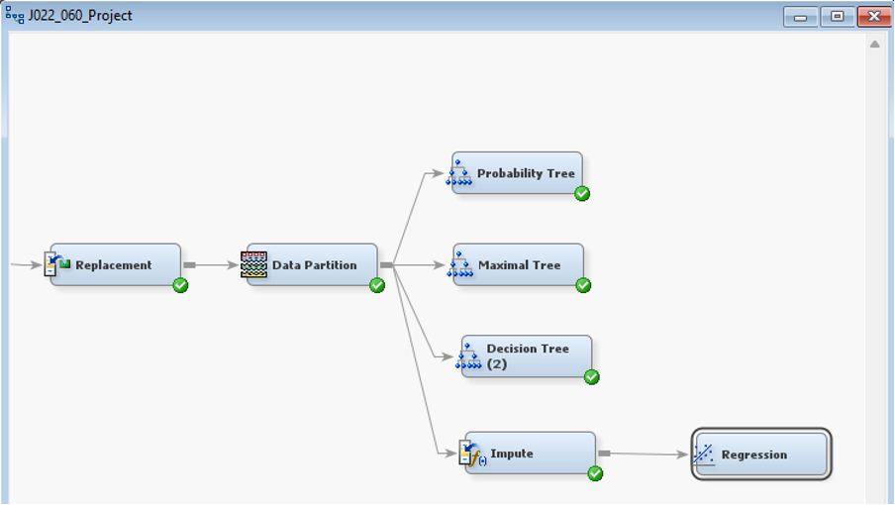
REGRESSION NODE

Slide 27
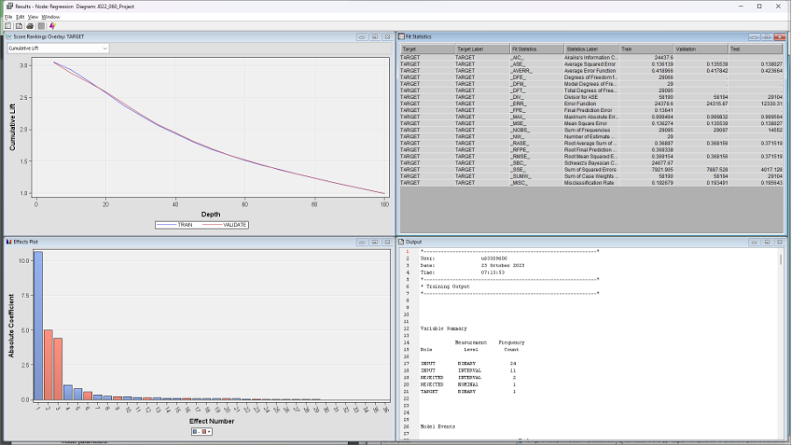
REGRESSION NODE

Slide 28
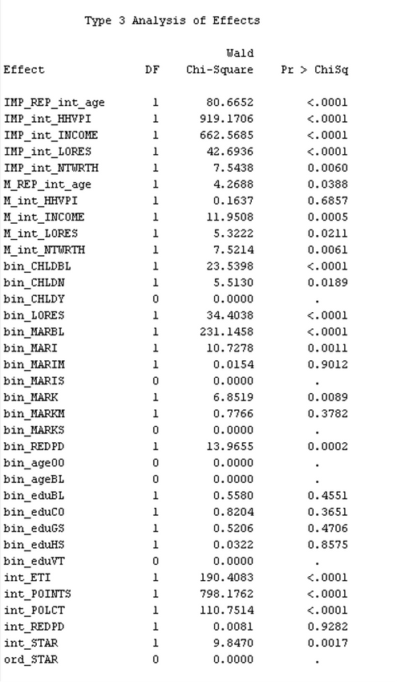
REGRESSION NODE
The statistical significance measures a range from <0.0001 (highly significant) to 0.9593 (highly dubious). Results such as this suggest that certain inputs can be eliminated without affecting the predictive prowess of the model.

Slide 29
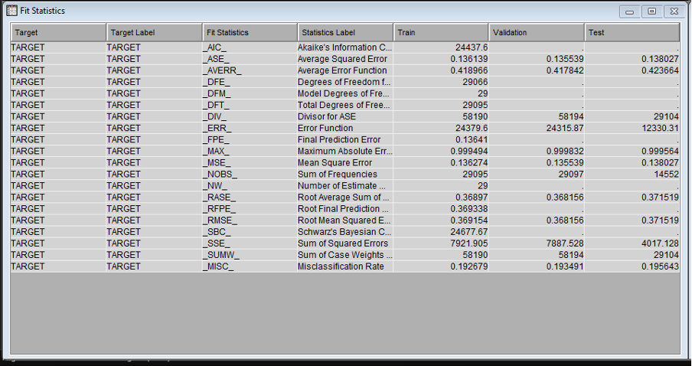
REGRESSION NODE
If the decision predictions are of interest, model fit can be judged by misclassification. If estimate predictions are the focus, model fit can be assessed by average squared error. There appears to be some discrepancy between the values of these two statistics in the train and validation data. This indicates a possible overfit of the model. It can be mitigated by using an input selection procedure.

Slide 30
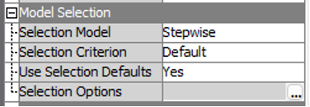
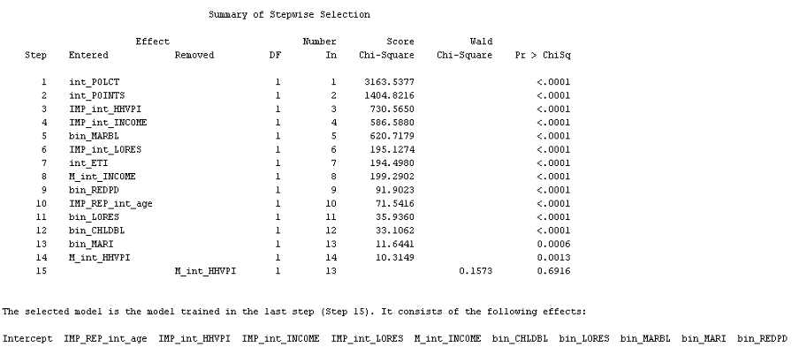
REGRESSION NODE
The summary shows the step in which each input was added and the statistical significance of each input in the final eight-input model.

Slide 31
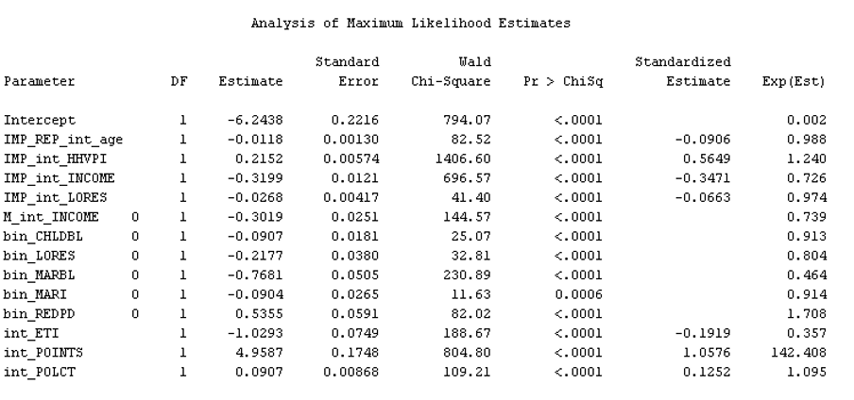
REGRESSION NODE
The parameter with the largest standardized estimate (in absolute value) is int_POINTS with a standardized estimate of 1.0576.

Slide 32
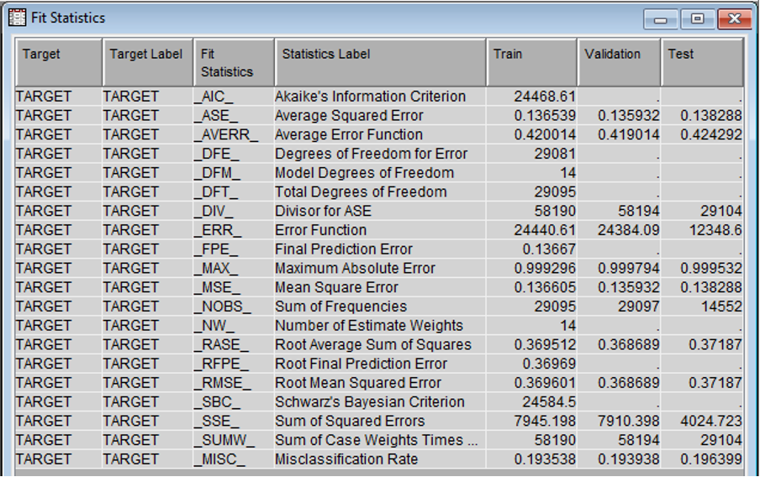
REGRESSION NODE

Slide 33
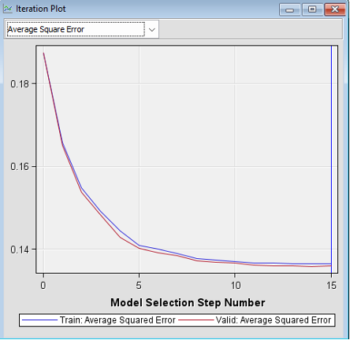
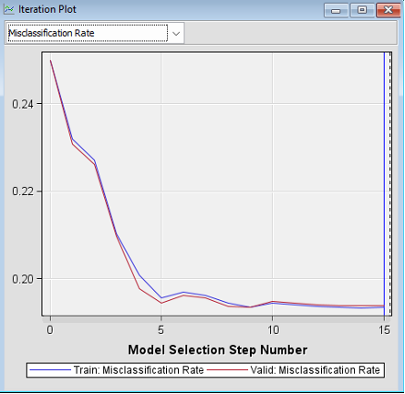
REGRESSION NODE
The simpler model improves on both the validation misclassification and average squared error measures of model performance.

Slide 34
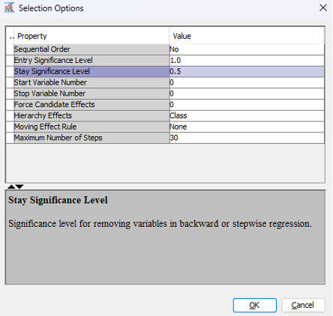
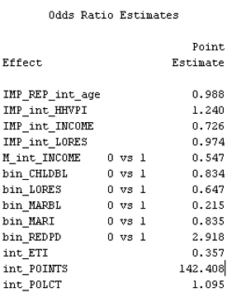
ODDS RATIO ESTIMATE

Slide 35
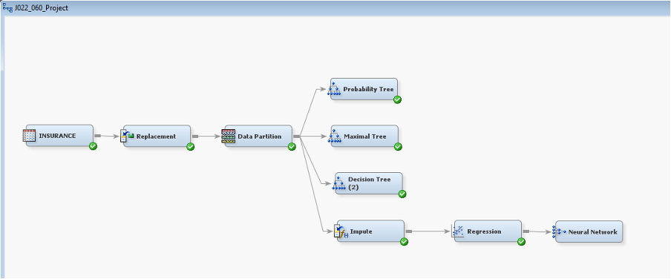
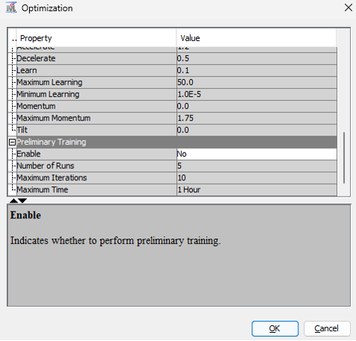
NEURAL NETWORK
Disabled preliminary training and ran the node.

Slide 36
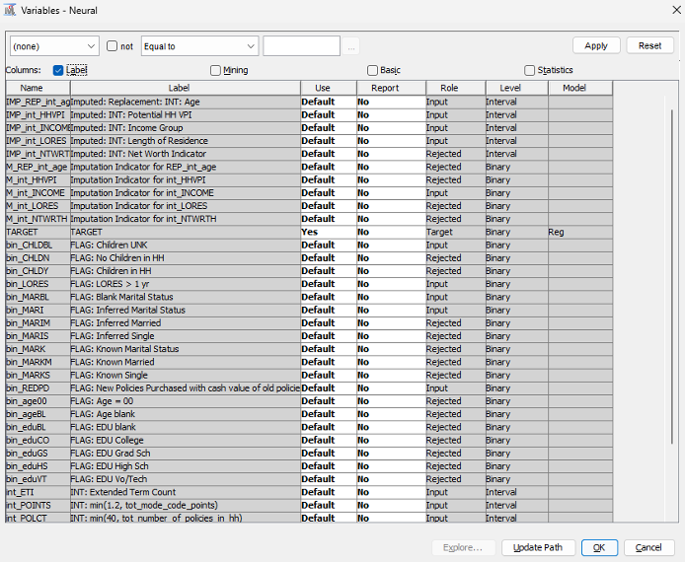
NEURAL NETWORK
Only the inputs selected by the Regression node's stepwise procedure are not rejected.

Slide 37
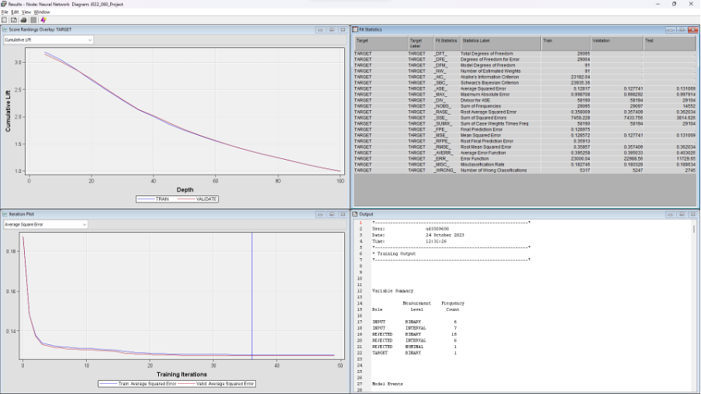
NEURAL NETWORK
Number of Estimated Weights for the TARGET variable is 91.

Slide 38
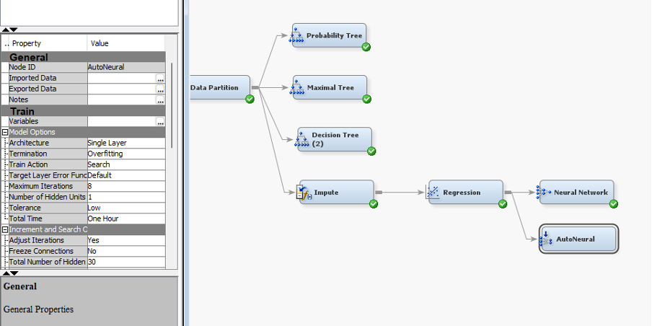
NEURAL NETWORK
Confirm that this setting is in effect: Train Action Ö Search. This configures the AutoNeural node to sequentially increase the network complexity.
Select Number of Hidden Units 1. With this option, each iteration adds one hidden unit.
Select Tolerance Low. This prevents preliminary training from occurring.
Select Direct No. This deactivates direct connections between the inputs and the target.
Select Normal No. This deactivates the normal distribution activation function.

Slide 39
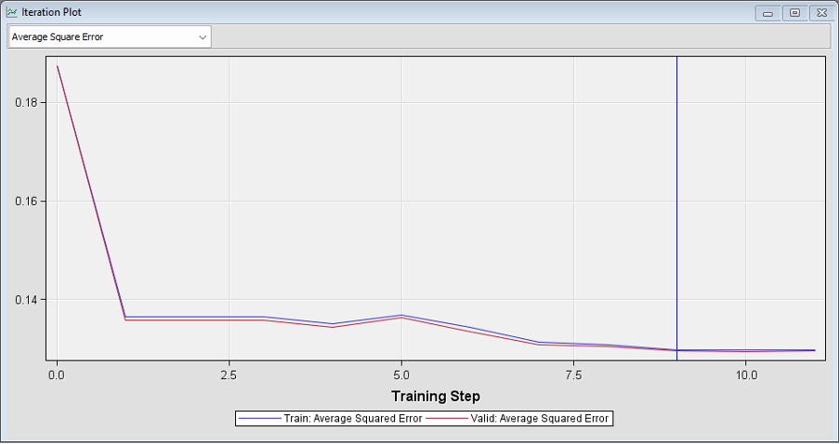
NEURAL NETWORK
The AutoNeural and Neural Network node's iteration plots differ. The AutoNeural node's iteration plot shows the final fit statistic versus the number of hidden units in the neural network.

Slide 40
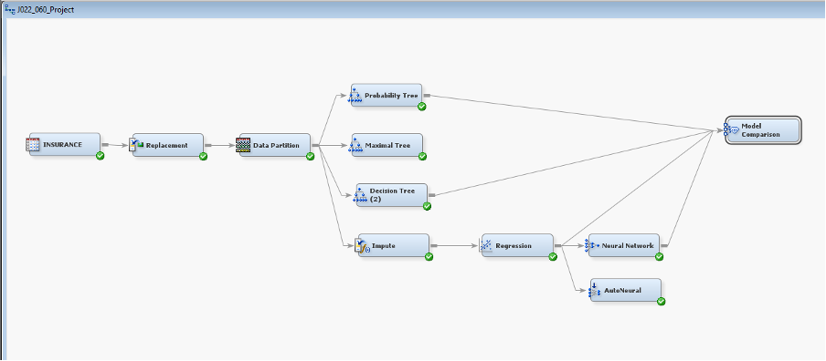
MODEL COMPARISION

Slide 41
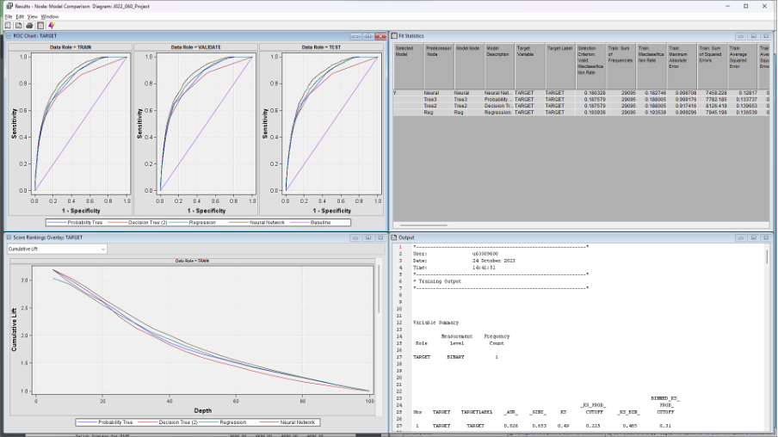
MODEL COMPARISION
The Results window contains four sub-windows: ROC Chart, Score Rankings Overlay plot, Fit Statistics, and Output.

Slide 42
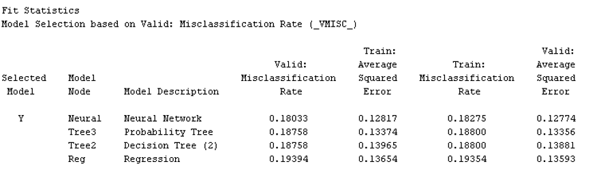
MODEL COMPARISION
The regression model was selected based on the Validation data: Misclassification rate. SAS Enterprise Miner assumes decision processing and selects the model with the lowest misclassification rate when there is a binary target.

Slide 43
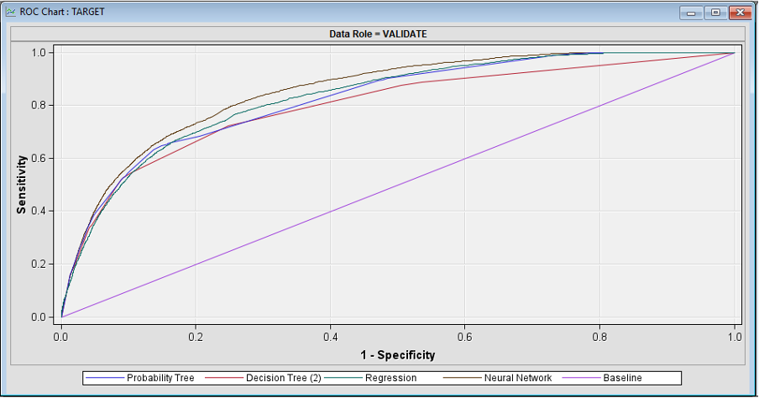
MODEL COMPARISION
The ROC chart shows little difference between the non-tree models. This is consistent with the values of the ROC index, which equals the area under the ROC curves.

Slide 44
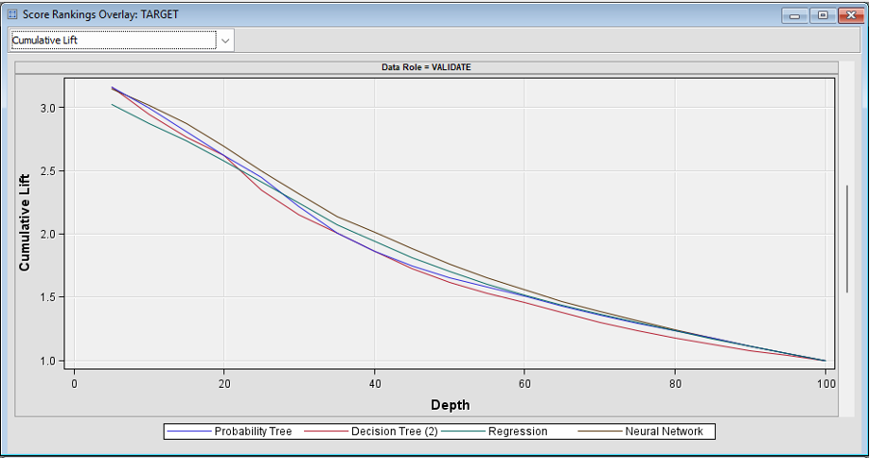
MODEL COMPARISION
The Score Rankings Overlay plot presents what is commonly called a cumulative lift chart. Cases in the training and validation data are ranked based on decreasing predicted target values.

Slide 45

THANK YOU

